Slide 1
Hydromagic Survey
Eye4Software B.V.

Slide 2
Today’s Topics
1. Software Installation
2. Project Preparation
3. Recording Data
4. Post Processing

Slide 3
Software Installation - Download
Installer package can be downloaded free of charge from the Eye4Software website: https://www.eye4software.com/download.
Always make sure you select the “FULL” version when you own a license (computer bound or dongle bound license).
For Windows 10 and Windows 11, please select the 64-bit version, as it can handle larger amounts of computer memory (> 4GB).
To keep the installer package compact, geoid and correction grid data are not included. They can be installed form within the software.
Older versions and offline documentation (PDF’s) can be found in the download archive: https://www.eye4software.com/archive.

Slide 4
Software Installation - Download

Slide 5
Software Installation - Installer
After download, go to the downloads folder of your PC and execute the installer (preferably as an Administrator).
To run the installer as an Administrator, right click the installer file and select the “Run as administrator…” option from the menu.
It is possible that the Administrator password must be entered.
When not executed as an Administrator, it is possible that some folders and files are read-only after installation, causing issues.
When a popup displayed, with the question if you want to allow the software from an unknown publisher wants to make changes to your PC, click “OK” or “Allow”.

Slide 6
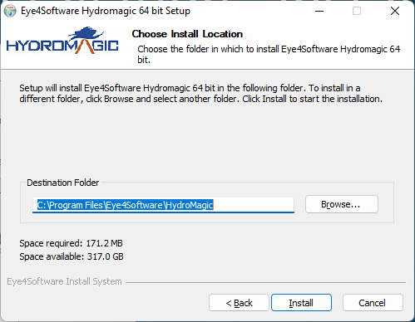
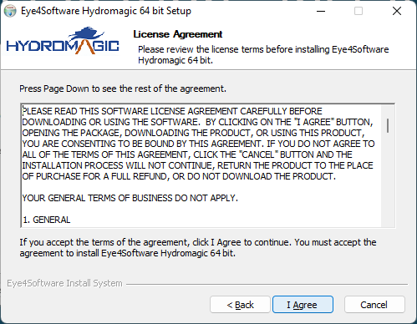
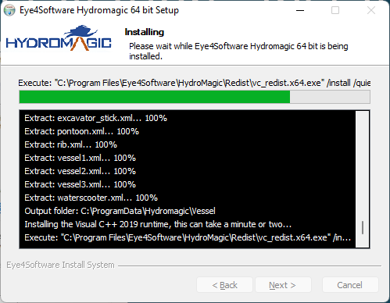
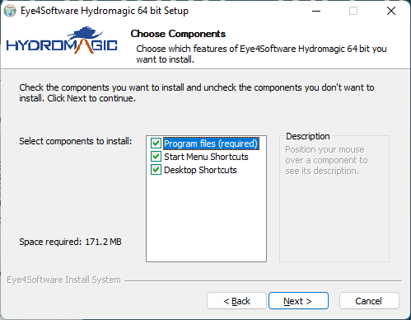
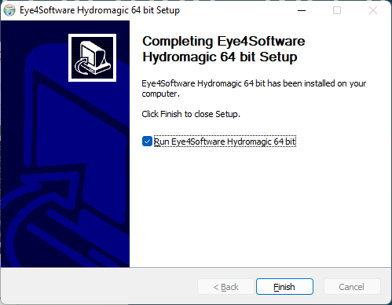
Software Installation - Installer

