Slide 1
Hydromagic Survey
Eye4Software B.V.

Slide 2
Today’s Topics
1. Software Installation
2. Software Configuration
3. Project Preparation
4. Recording Data
5. Post Processing

Slide 3
Software Configuration - Units
To be able to use Hydromagic worldwide, it support multiple units for area, volume, speed, sound velocity, distance and temperature.
The geographic position format (latitude and longitude values) can be selected as well.
Vertical and horizontal distance units are set by the map projection and cannot be changed after selecting a map projection.
Other units can be changed from the “Units” tab of the preferences window, which can be accessed by selecting the “Preferences” option from the “Options” menu.

Slide 4
Software Configuration – Static Draft
Static draft means the distance between the bottom of the echo sounder transducer and the water surface. This value needs to be added to the measured depth (unless configured in the echo sounder).
To enter the static or fixed draft in Hydromagic, open the “Preferences” window by selecting the “Preferences…” option from the “Options” menu.
When the static draft has not been configured in the echo sounder, check the “Apply echo sounder offset” box and enter the absolute value in the “Transducer Offset” box. Click “OK” to save this setting.

Slide 5
Software Configuration – RTK Tides
RTK Tides is a feature which can be used when a RTK GNSS receiver is used. By measuring the elevation of the antenna with heigh precision, the current water level (tide) can be measured, and depths can be measured against the local vertical datum.
To calculate the elevation of the water level, the antenna height and geoid model for the area must be configured. To do so, select the “Preferences” option from the “Options” menu and click the “RTK” tab.
Click “Select…” to select a geoid model from the list. When a geoid model isn’t installed on the computer it is displayed in red. In this case, right click the item and select the “Download and Install…” option to install it.
When using RTK tides, an error message is displayed on the screen when the RTK fix is lost during data recording.

Slide 6
Software Configuration – Data View
In Hydromagic, the “Navigation Data View” shows the last known data values received from sensors such as the GNSS receiver, echo sounder and motion sensor.
When data is invalid, or hasn’t been received the last two seconds ,the color will change from green to red.
You can customize the data view by right clicking it. The items to be displayed can be selected and the font size and update rate can be adjusted.

Slide 7
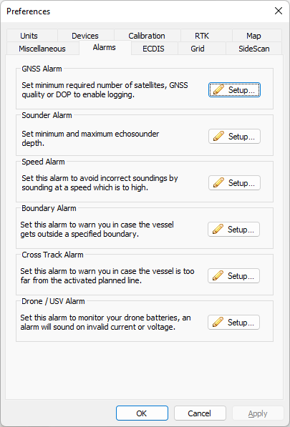
Software Configuration - Alarms
It is recommended to set alarms to receive an early warning when something is wrong with your equipment. Multiple alarms can be configured.
GNSS Alarm: Set the minimum DOP and fix quality for your GNSS receiver. When using RTK tides, make sure the minimum quality is set to “RTK Fix”.
Sounder Alarm: Set the upper and lower limit to depth values you will be expecting.

