Slide 1


Hydromagic Survey
Eye4Software B.V.

Slide 2
Today’s Topics
1. Software Installation
2. Software Configuration
3. Project Preparation
4. Recording Data
5. Post Processing

Slide 3
Project Preparation – New Project
In Hydromagic, maps, raw data, soundings, waypoints, routes, comments and other files are organized in a project.
Before you start recording sounding data, you must create a project and select the map projection.
Projects can be transferred between computers by copying or moving the folder structure using an USB stick or external HD.
Most menu options will be disabled until a project has been created.
To start a new project, select the “New Project…” option from the “File” menu.

Slide 4
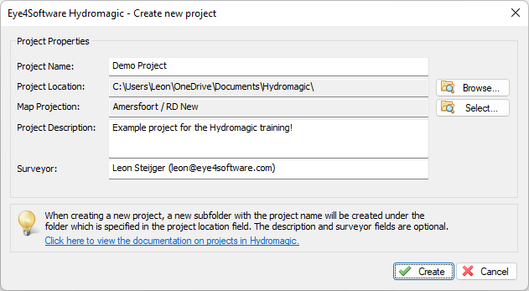
Project Preparation – New Project
The project name, location and map projection are required settings. You can use the other fields for additional information; Click the “Select…” button to choose a map projection for the project.

Slide 5
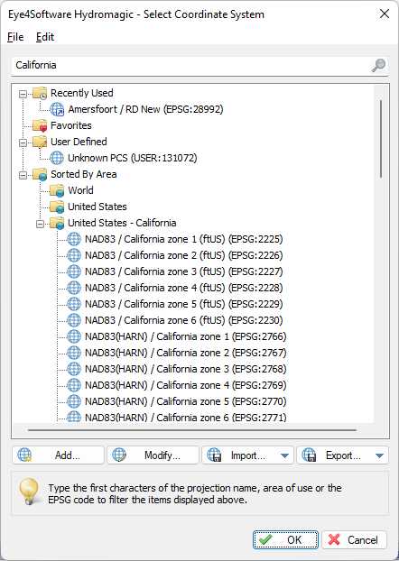
Project Preparation – Map Projection
A map projection is required. It is not possible to record data in WGS84 (can be exported in WGS84 after processing though).
More then 5000 map projections are built-in. Extra map projections can be added by user.
Software supports geoid models, NTv2 correction grid (GSB), NADCON, HARN and horizontal correction grids (RD, JTSK, Lb72).
Recently used map projections will be shown on top of the list.
You can mark map projections as favorite.
Type the name of the area, projection, map datum or EPSG or ESRI ID to search for a map projection. When selected, click “OK”.

Slide 6
Project Preparation – Map Import
Map files can be import by selecting “Import Map…” from the “File” => “Import” menu, or by clicking the toolbar button.
Supported vector formats include: AutoCAD DXF, ESRI Shape File, Arc/Info coverage, KML, S-57, S-63 and many more.
Supported raster formats include: GeoTIFF, BMP, JPEG, PNG, TIF, and GIF image files, BSB files (KAP).
World and projection files are supported, to place the image at the correct location in case of raster files.
When no map data is available for your location, you can use the built-in map downloader as discussed on the next page.

Slide 7
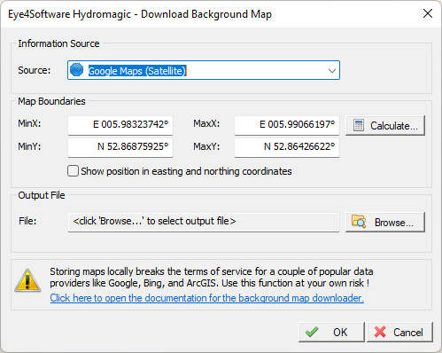
Project Preparation – Map Download
Use the map downloader when no map is available in either one of the supported vector or raster formats.
Maps can be downloaded from Google Maps, Bing Maps, ESRI or an OpenStreetMap server.
Click the “Calculate…” button to calculate the map coverage using a GNSS position, street address, or an existing raw data file, map, sounding file or waypoint.
Select an output file in which the downloaded map data should be stored.
Click “OK” to start the download. When completed, the image will be georeferenced using the map project used in the project and the map will be added to the project automatically.

Slide 8
Project Preparation - Boundaries
In Hydromagic, a boundary can be used to generate cross sections, routes and to clip data when generating matrices or volume reports.
Select the “Draw Boundary” option from the “Cursor” menu to start drawing a boundary.
The boundary should define your survey area. Left click to add points, click right end drawing.
To define an island, draw a boundary inside a boundary and select both boundaries.

Slide 9
Project Preparation – Cross Sections
Sections can be used in routes, for steering guidance and in volume calculations.
Cross sections can be auto generated or placed manually. In this example we place one cross section manually and use this one as template to create the others.
Right click on the map display and select the “Add Section…” option. In the dialog which appears click “OK”.
When clicking and dragging the section on the end points, the length and direction can be changed. Make sure it is in the preferred direction.
When clicking and dragging the section on the center point, it’s center position can be changed.

Slide 10
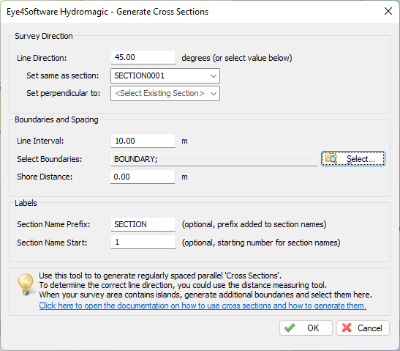
Project Preparation – Cross Sections
Right click the “Sections” folder in the “Project Explorer”. and select the “Generate Sections…” option from the popup menu.
Select the cross section you generated as a template, which is in the direction you want to go.
Select a line interval. Which distance to use depends on the required accuracy, the size of the area and the beam angle of the sounder.
When you want to use the sections in the route planner ,you might want to keep a certain distance from the shore. You can use the shore distance setting to do this.

Slide 11
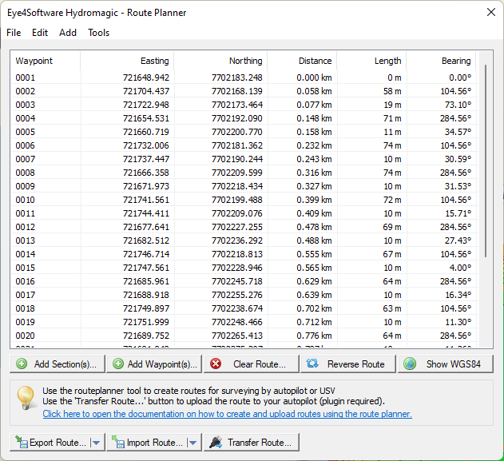
Project Preparation – Route Planner
When your USV has an onboard autopilot, you can plan and program your survey route in Hydromagic using the built-in route planner tool.
You can create a route by adding waypoints or cross sections. Hydromagic will find the shortest route between all points.
When the MAVLink (ArduPilot) or SPECTRE (Dynautics) plugin has been loaded, the route planner can transfer the generated route directly to the autopilot (via Serial or Wi-Fi).

Slide 12
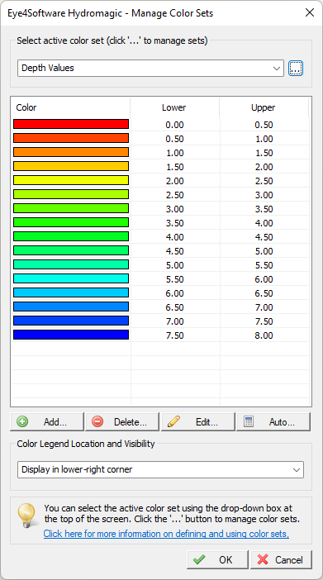
Project Preparation - Colors
Depending on display settings, depths or elevations are represented by different colors. Before starting your survey, make sure you created a color set. Color sets can always be changed.
The “Manage Color Sets” window can be opened by selecting the “Depth Colors…” option from the “Options” menu.
To auto-generate color ranges for your project, click the “Auto…” button and enter the minimum and maximum expected depth for the survey area. Also set a step size. Please note that a maximum of 30 different colors can be used.

