Slide 1


Hydromagic Survey
Eye4Software B.V.

Slide 2
Today’s Topics
1. Software Installation
2. Software Configuration
3. Project Preparation
4. Recording Data
5. Post Processing

Slide 3
Post Processing – Generate Soundings
During the post processing process raw data files are converted to sounding files after being edited and filtered.
When soundings have been generated, they can be used in volume calculations, to generate a DTM or to export data.
This is done in the so called “Sounding Wizard” which can be started by selecting the “Generate Soundings…” option from the “Tools” menu.

Slide 4
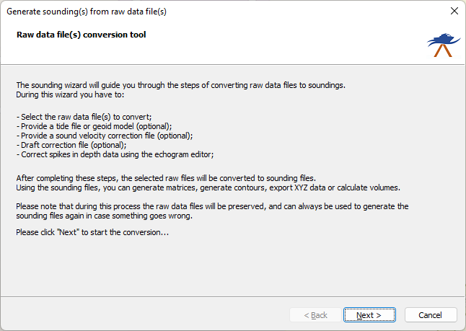
Post Processing – Generate Soundings
The first page of the “Sounding Wizard” only contains some information on what it does and what steps will follow.
After reading this information, click the “Next” button to advance to the next page of the wizard.

Slide 5
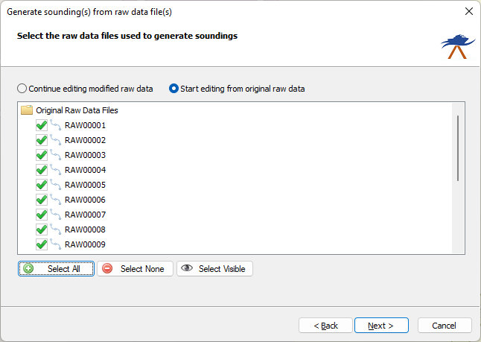
Post Processing – Generate Soundings
Select which raw data files you want to edit. You can start over or continue files which were already edited in an earlier session.
Original raw data files are in the “RawData” folder of the project. Files which were already edited are stored in the “Modified” folder of the project.

Slide 6
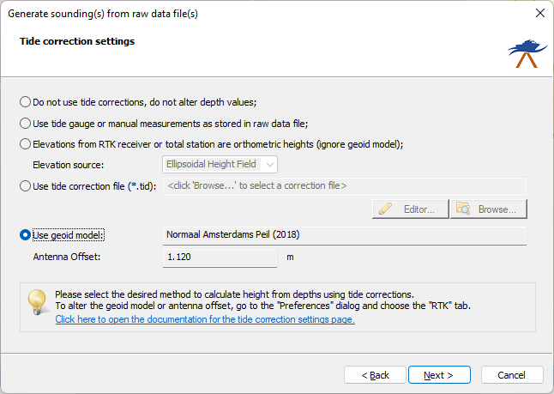
Post Processing – Generate Soundings
Select the tide correction settings in this page. When not using tides, always select the first option. This will generate a sounding file containing corrected depths only and with no elevation information.
When using RTK tides, select the use “Geoid Model” and make sure the correct geoid and antenna height are set in the “RTK” tab of the preferences window ( the “Preferences” option from the “Option” menu.

Slide 7
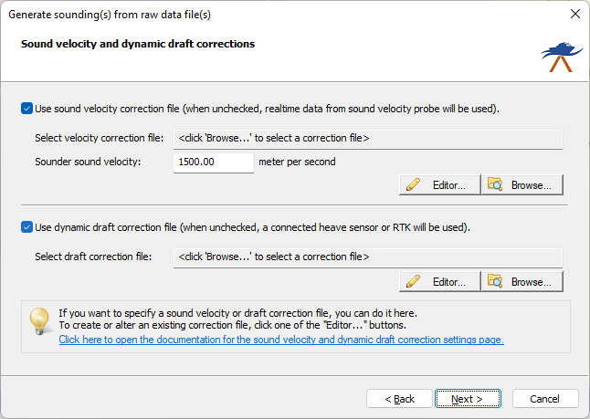
Post Processing – Generate Soundings
Sound Velocity correction is optional and should not be used when surveying in fresh water. Only to be used at sea.
Draft corrections are only used when your vessel squats when more speed is made.
This can be ignored when using RTK.

Slide 8
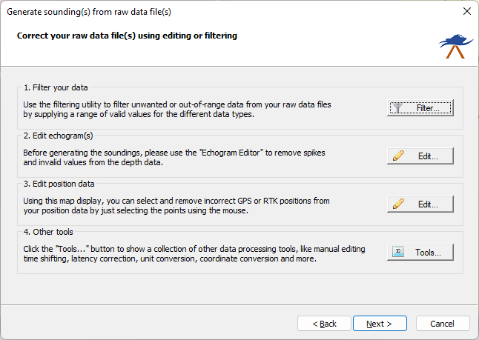
Post Processing – Generate Soundings
Filter your data – Tool to apply range filters to depth, position, motion and elevation data.
Edit echograms – Tool to edit the echogram (depth vs time) using various selection and eraser options.
Edit position data – Enables you to remove or filter outlying position data
Other tools – Collection of more advanced tools. Not covered in this training.

Slide 9
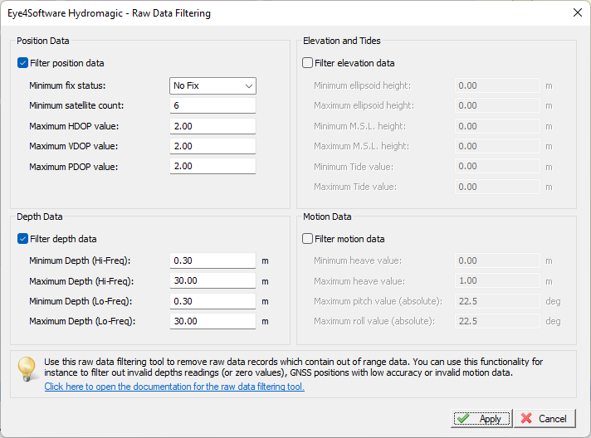
Post Processing – Generate Soundings
Position Data: Remove unreliable position data taken from fixes with bad DOP, satellite count or lost fix.
Depth Data: Remove data outside the given range (0.30-30.0 meter in this example).
Elevation and Tides: Remove invalid elevation data from tide receiver, ellipsoid or mean sea level fields from the GNSS receiver.
Motion Data: Filter invalid heave and motion values which are unrealistic for the weather conditi0ns during the survey.

Slide 10
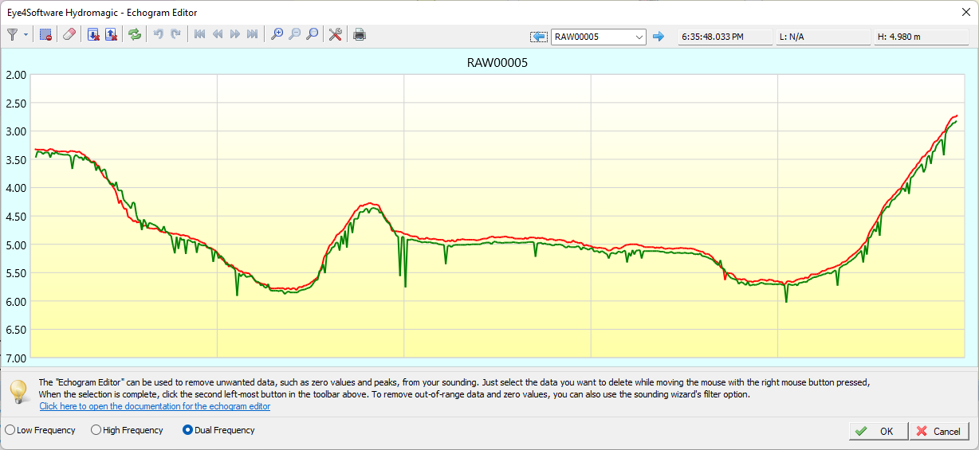
Post Processing – Generate Soundings
Use the Echogram Editor to remove spikes from the data. Various tools and filters are available to get rid of all spikes and other invalid values.

Slide 11
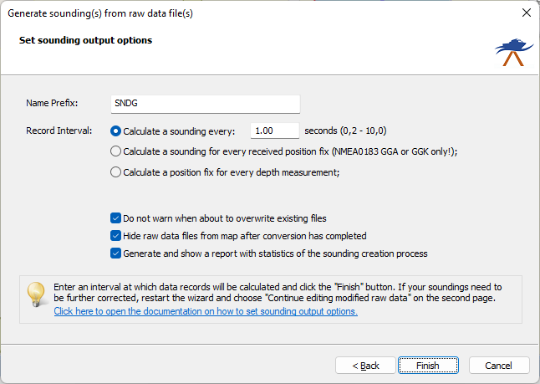
Post Processing – Generate Soundings
Finally, enter a file name prefix for the sounding files to be generated. This allows you to generate multiple sets of sounding from the same raw data. For instance, a depths and an elevation set.
Records can be generated at a fixed time interval, on pings or GNSS fixes. In most cases use a fixed interval of one second.
Enable the third checkbox to get a report on the sounding generation process. This is especially helpful to find the cause of missing data.

Slide 12
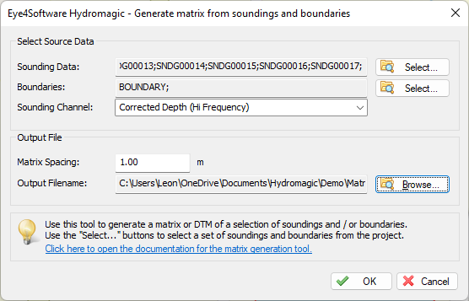
Post Processing – Generate Matrix
In Hydromagic, a matrix is a regularly spaced grid generated from interpolating sounding values. It can be used to generate depthor elevation contours, a 3D view or to calculate volumes.
To generate a sounding, select the “Generate Matrix…” option from the “Tools” menu. The window as shown on the left will show up.
Select all soundings you want to include in the calculation. The data can be clipped by selecting a boundary as well. A matrix can be generated from either depth or elevation data.
When there is an island in the survey area, create a boundary for it and add it to the boundaries selection.
An example matrix is shown on the left. If nothing appears, please double check the “Depth Color” settings for your project.

Slide 13
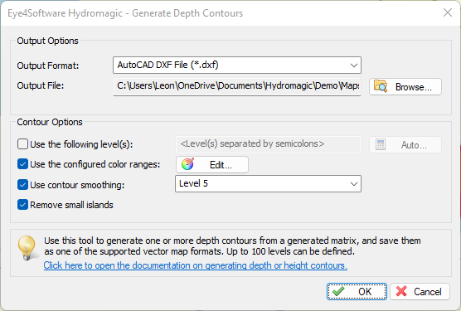
Post Processing – Generate Contours
To generate depth or elevation contours in Hydromagic, right click a matrix in the “Project Explorer” and select the “Generate Contours…” option from the popup menu which appears.
Contours can be generated at color transitions, or at user defined depth or elevation values.
Contour lines can be smoothened with nine different smoothing levels.
Contour lines can be saves as either AutoCAD DXF or ESRI Shape files. The generated contour file will automatically be added to your project. By default, the contour maps are stored into the “Map” folder.

Slide 14
Post Processing – Export ASCII Data

